Slide 5
Comprehensive School Mental Health
Sharon Hoover, PhD, Professor
National Center for School Mental Health (NCSMH), Co-Director
National Center for Safe Supportive Schools (NCS3), Director
@drsharonhoover @NCSMHtweets @NCS3tweets
First Focus Mental Health Briefing
March 2022
Notes:
LINKS for this presentation
National Center for School Mental Health
http://www.schoolmentalhealth.org/
The School Health Assessment and Performance Evaluation (SHAPE) System
https://www.theshapesystem.com/
School Mental Health Guidance from the Field
http://www.schoolmentalhealth.org/Resources/Foundations-of-School-Mental-Health/Advancing-Comprehensive-School-Mental-Health-Systems--Guidance-from-the-Field/
State School Mental Health Report Cards
https://hopefulfutures.us/wp-content/uploads/2022/02/Final_Master_021522.pdf
Hopeful Futures Polling Research and Action Center
https://hopefulfutures.us/

Slide 6
Multi-Tiered System of Supports (MTSS)

Slide 7
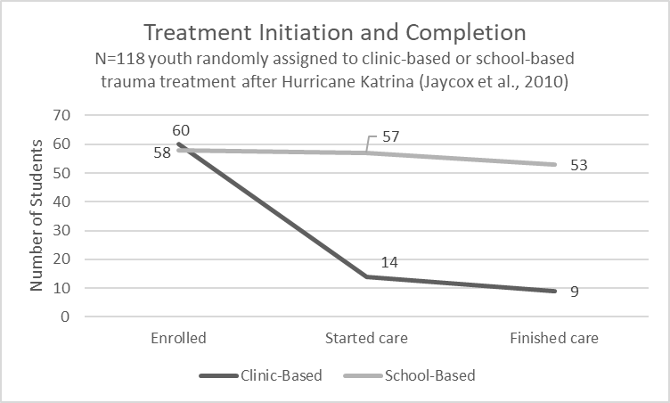
Why Mental Health Treatment in Schools?
Youth are 6x more likely to complete mental health treatment in schools than in community settings (Jaycox et al., 2010)

Slide 9
Coalition partners—and more are coming on board

Slide 10
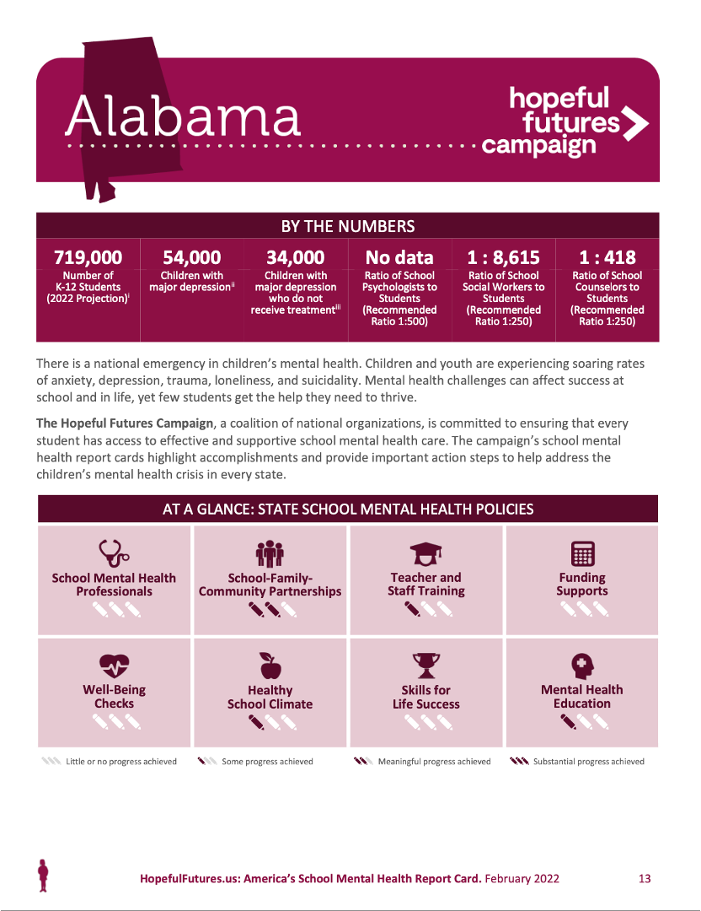

Slide 11
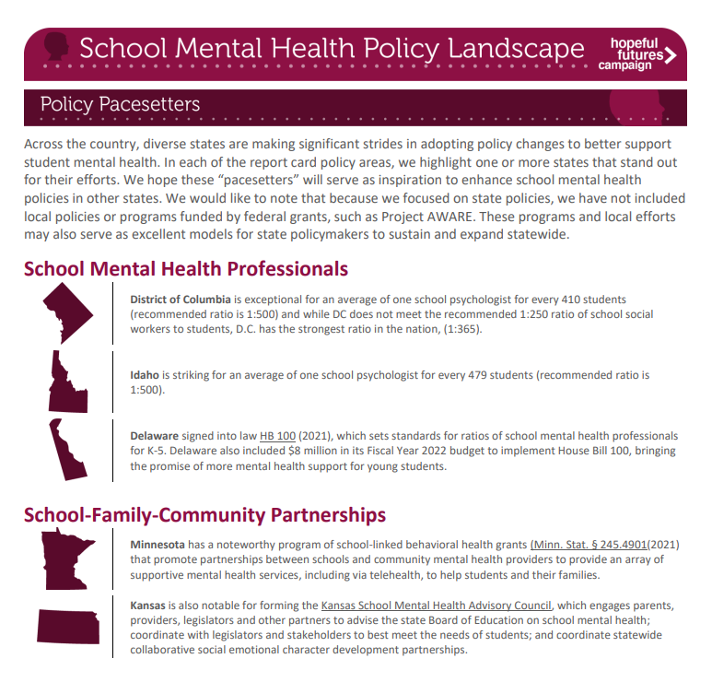

Slide 14
Building a Comprehensive School Mental Health System in Michigan

Slide 15
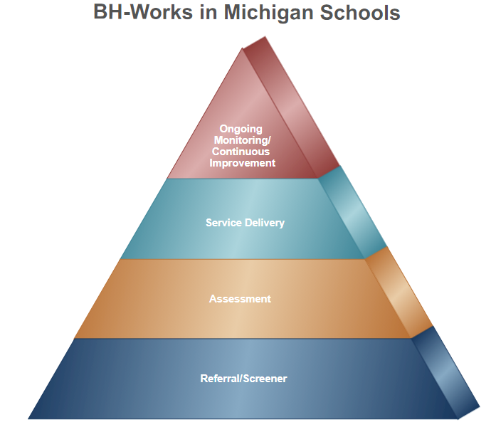
Using Technology to Connect Students to Services More Efficiently
Care Coordination Platform
Simplify the process for providers delivering comprehensive behavioral health services
Improve confidential communication with families, school staff and providers
Access to real-time data

Slide 16
What’s Next?

